Slide 1
Эффективные методы и приёмы подготовки учащихся к ГИА и ЕГЭ
Муниципальное бюджетное образовательное учреждение
средняя общеобразовательная школа № 1 г. Павлово
Словообразование
Китова Нина Юрьевна,
учитель английского языка
2013-2014 учебный год

Slide 2
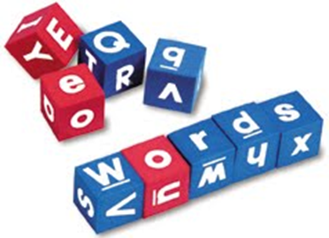
Цель работы: систематизация материала по словообразованию и разработка системы упражнений с целью совершенствования навыков в области словообразования.
Презентация будет полезной педагогу и
учащемуся при подготовке к ГИА и ЕГЭ.
Систематизация проводится от простого к сложному с увеличением и расширением информации:
изучение аффиксов с примерами, переводом и классификация их по значению и частям речи
система интерактивных упражнений, направленных на формирование навыков словообразования
использование ресурсов сети Internet на предмет наличия тестов на словообразование on-line (“копилка” полезных сайтов)

Slide 3
Способы словообразования в английском языке
1. Конверсия (образование новых слов без изменения их написания и произношения) to play – a play
2. Словосложение (образование слова путем сложения двух слов в одно) a snowman
3. Изменение ударения в слове ( получение слова другой части речи) a present – to present
4. Аффиксация (прибавление к корню суффикса или префикса) to reread, changable
http://www.englishege.ru
http://scholar.urc.ac.ru

Slide 4
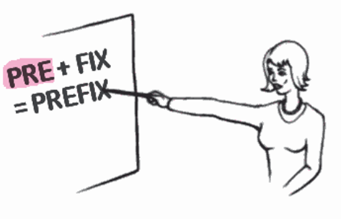
Аффиксация – один из самых распространенных способов словообразования, образование новых слов от основ существующих слов при помощи аффиксов (суффиксов и префиксов).
Аффикс - часть слова, имеющая грамматическое значение и вносящая некоторое изменение в значение корня. По положению относительно корня словообразовательные аффиксы подразделяются на стоящие перед корнем — префиксы, после корня — суффиксы и внутри корня — инфиксы.
Аффикс - это морфема, которая присуща целому классу слов и имеющая характерные признаки.
Присоединяясь к основе,
она изменяет ее значение.

Slide 5
Упражнения по словообразованию на II ступени обучения
6 класс
Составьте пары слов:
Win
gymnast
cyclist
football
finishing
champion
play

Slide 6
Составьте слова и заполните ими пропуски в предложениях:
Deco
Stoc
Tin
Christ
Pre
Fire
Cra
Christmas and the New Year are the best festivals of the year. Before Christmas, people decorate their houses with lights and ___________ . People decorate the _____________ tree with toys, ____________ and lights. They put ______________ for all the family under the tree. Children hang ______________ for Father _______________ near the fireplace.

Slide 7
7 класс
Make up new words from the given verbs and fill in the gaps:
Sing drum guitar play dance compose
A pop group can have many forms, but a traditional one has a single lead singer. There is nearly always a (1) ____________ sitting behind his drams and two or three (2) ___________ playing electric guitars. Nowadays there is always a keyboard (3) ___________ .
Finally some groups have a saxophone player and might even have one or two (4) ______________ .
Some groups have their own songwriter and (5) ___________ who write the lyrics and music for them.

Slide 8
Describe these people with adjectives from the box:
Example: Peter likes doing sport. – Peter is sporty.
Andrew likes dreaming.
Boris never stops chatting.
Kate always does her homework and she works hard at school.
I always talk to Jane about my problems and feelings. Jane can always understand me.
Max is always nervous when he meets new people.
Ann always feels sure that she is doing the right thing.
Bob is always thinks only about herself and never about other people.

Slide 9
8 класс
Choose the best word to make up a sentence
Example: He speaks German very well/ very good.
Can I have a quick / quickly word with you?
The teacher explained the task clear / clearly.
I usually spell the words correct / correctly.
My dad drives his car careful / carefully.
My neighbor have a beautiful / beautifully cat.
Tom’s uncle has travelled a lot and always tells interesting / interestingly stories.

Slide 10
9-11 классы
Correct the mistakes in the sentences
Make any necessary changes
We tried to make her change her mind, but we
It’s a difficult test, but she seems quite
My little brother has won the music contest – I am of him.
She had a lot of before she found the right way to do it.
When you have had more experience, you become more
speaking in front of groups of people.

Slide 11
Verb | Noun (person or machine) | Abstract noun (-ion/-ment/-ing)
simulate
generate
produce
conduct
govern
examine
develop
train
Achieve
grow
measure
operate
limit
begin
visit
meet
enter
organize
appear
sudden
care
achievement
growth
measurement
operation
limitation
beginning
visitor
meeting
entrance
organization
appearance
suddenness
care
simulator simulation
generator generation
producer production
conductor conduction
examiner examination
developer development
trainer training

Slide 12
NOUNS | VERBS | ADJECTIVES
_____SMOKER _____AGREEMENT _____ABILITY _____ORDER _____COMFORT | ______TIE ______MOTIVATE ______COVER ______COLONISE | ______POSSIBLE ______HONEST ______LOGICAL ______RESPONSIBLE ______VIOLENT
NON
DIS
IN
DIS
DIS
UN
DE
DIS
DE
IM
DIS
IL
IR
NON
I went on a short art course at the weekend. It was very interested/interesting.
We had two teachers : a painter and a sculpter/sculptor. They were both very helpful/helpless and showed us some good techniques. My drawings looked less childy/childish than they usually do. I’d like to go again. It was a good way of relaxing after a stressed/stressful week and I learnt a lot.

Slide 13
hope |  | history |  | impress
enjoy |  | silk |  | harm
ambition |  | care |  | child
hair |  | fury |  | revolution
trouble |  | fool |  | economy
practice |  | music |  | atom
hopeful/less
historical
impressive
enjoyable
silky
harmful/less
ambitious
careful/less
childish
hairy
furious
revolutionary
troubled
foolish
economic/al
practical
musical
atomic
Many societies have developed their own ________ systems. Some MEDICINE
_________systems , such as the Chinese, are still widely used. TRADITION
In the Middle Ages ,____________knowledge was mixed with SCIENCE
____________belief. People did not know much about the human RELIGION
body and surgery was very___________and__________ PAIN, DANGER
In the 19th century, medicine in Europe changed enormously and
became more_____________ as people began to understand what EFFECT
caused______________diseases. INFECT
traditional
scientific
religious
painful
dangerous
effective
infectious

Slide 14
«Копилка» полезных сайтов
http://www.englishege.ru/grammar/150-slovoobrazovanie-v-anglijskom-yazyke.html
http://www.examen.ru/add/tests/English
http://engblog.ru/subject/testy-na-slovoobrazovanie
http://bebris.ru/2012/04/28/Словообразование-тест-по-английском/
http://scholar.urc.ac.ru:8002/courses/English/rref/wform.html.ru

Slide 15
GOOD LUCK!

